Slide 1

LINEAR CONTROL
SYSTEMS
Ali Karimpour
Assistant Professor
Ferdowsi University of Mashhad
Notes:
<<<1.1>>>
###Control System Design###
{{{Control, Design}}}

Slide 2
Lecture 21
Frequency Domain Analysis
Topics to be covered include:
Frequency domain analysis of control systems.
Frequency domain specification.
  Peak of resonance and resonance frequency.
  Bandwidth.
  Effect of adding poles and zeros to open loop transfer function.
  Effect of adding poles and zeros to closed loop transfer function.

Slide 3
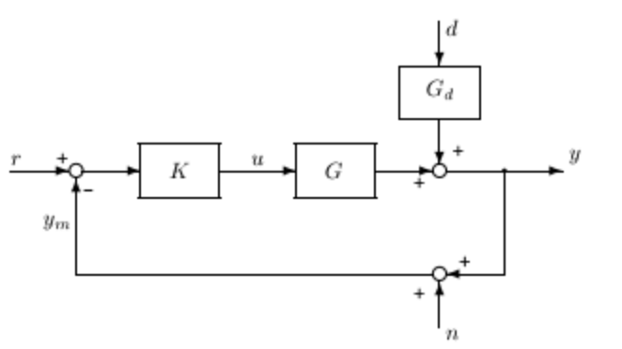
One degree-of-freedom configuration
T(s)
S(s)
T(s)
S(s) is : Sensitivity Function
T(s) is : Complementary Sensitivity Function
Why?
Since S+T=1

Slide 4
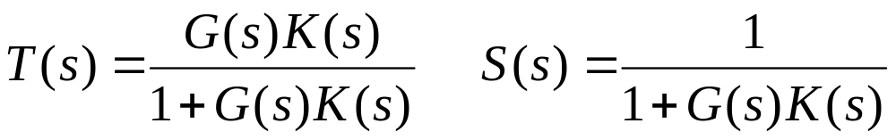







One degree-of-freedom configuration
Where T(s) and S(s) are
How to derive command tracking
How to derive disturbance rejection
How to derive noise attenuation

Slide 5
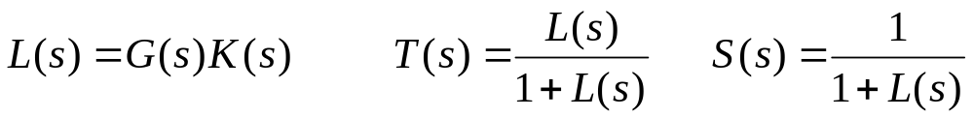





One degree-of-freedom configuration
Derive command tracking and disturbance rejection

Slide 6

One degree-of-freedom configuration
Derive command tracking and disturbance rejection
How to derive noise attenuation

Slide 7
One degree-of-freedom configuration
Ideal |T| for command tracking, disturbance rejection and noise attenuation
Ideal |L| for command tracking, disturbance rejection and noise attenuation
Actual |T| for command tracking, disturbance rejection and noise attenuation
Actual |L| for command tracking, disturbance rejection and noise attenuation

Slide 8
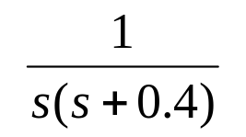

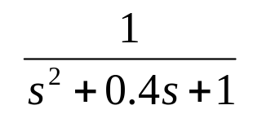
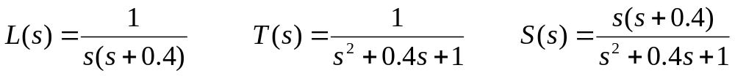
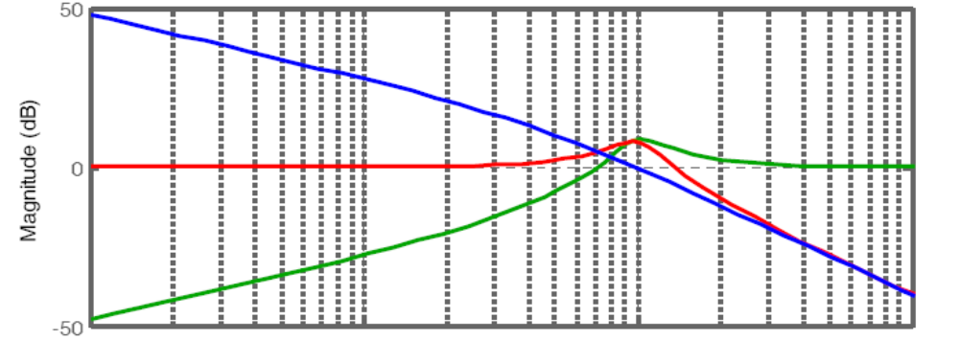



A prototype second order system.
یک سیستم نمونه درجه 2
+
e
r
c
-
r
c
Frequency (rad/s)

Slide 9
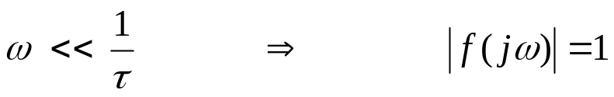
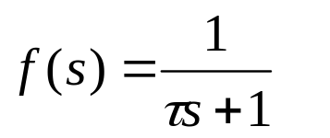
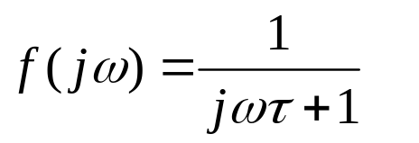
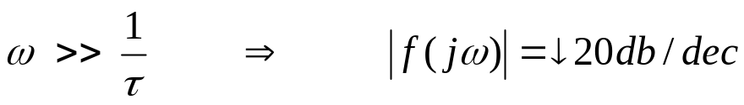
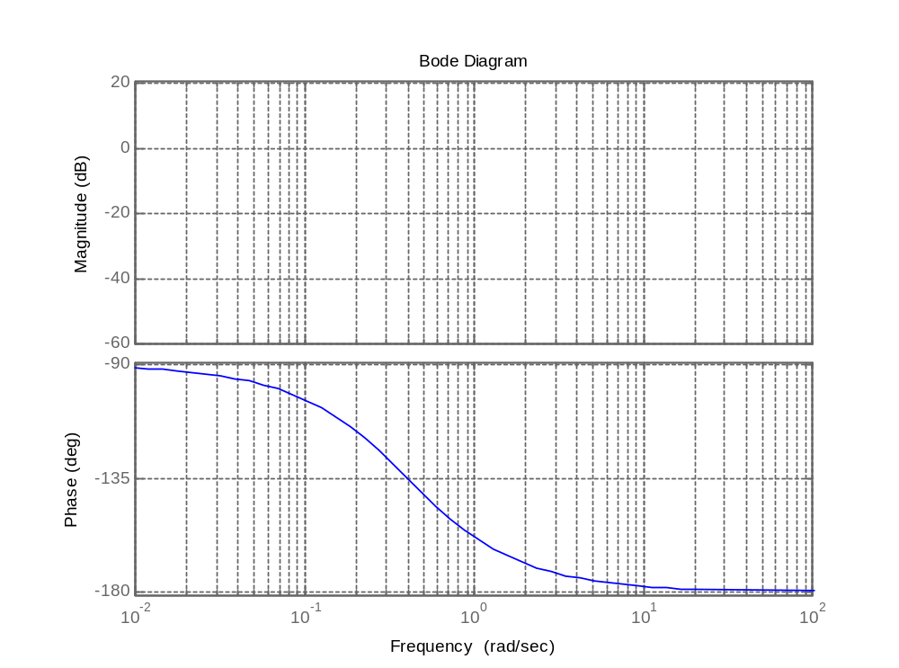

Drawing procedure

Slide 10
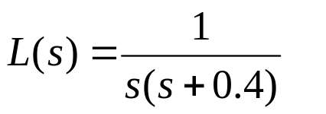
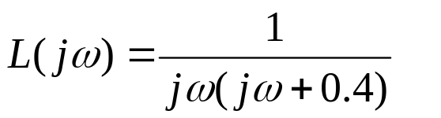
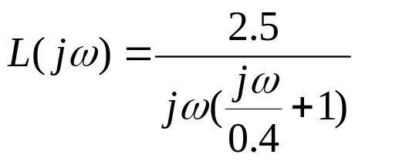
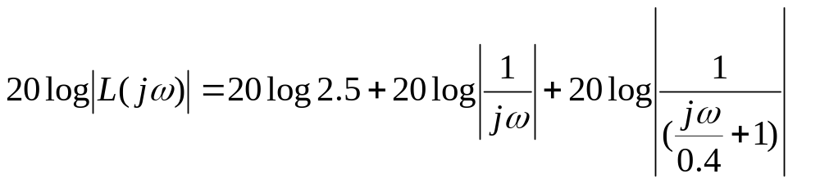
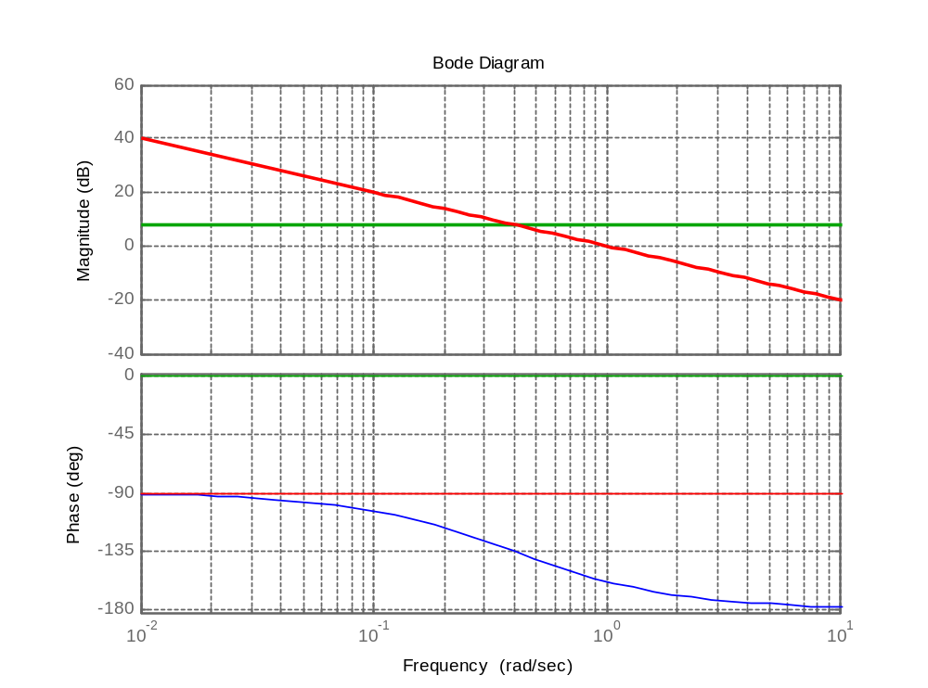
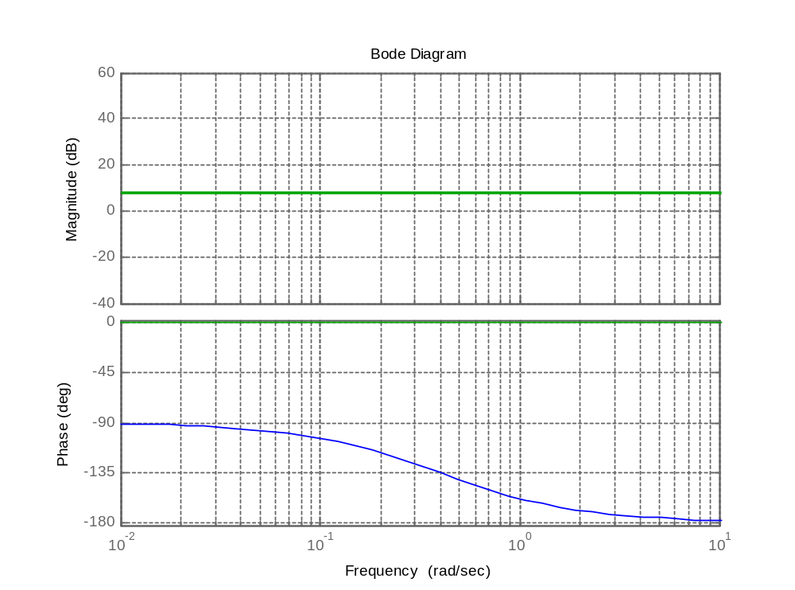
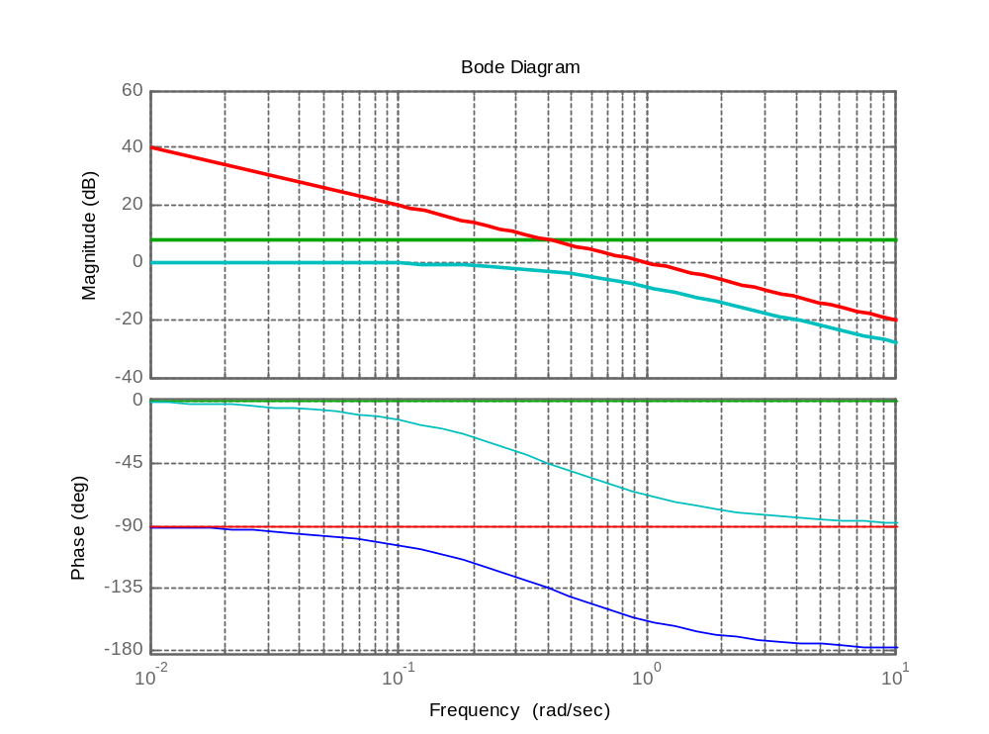
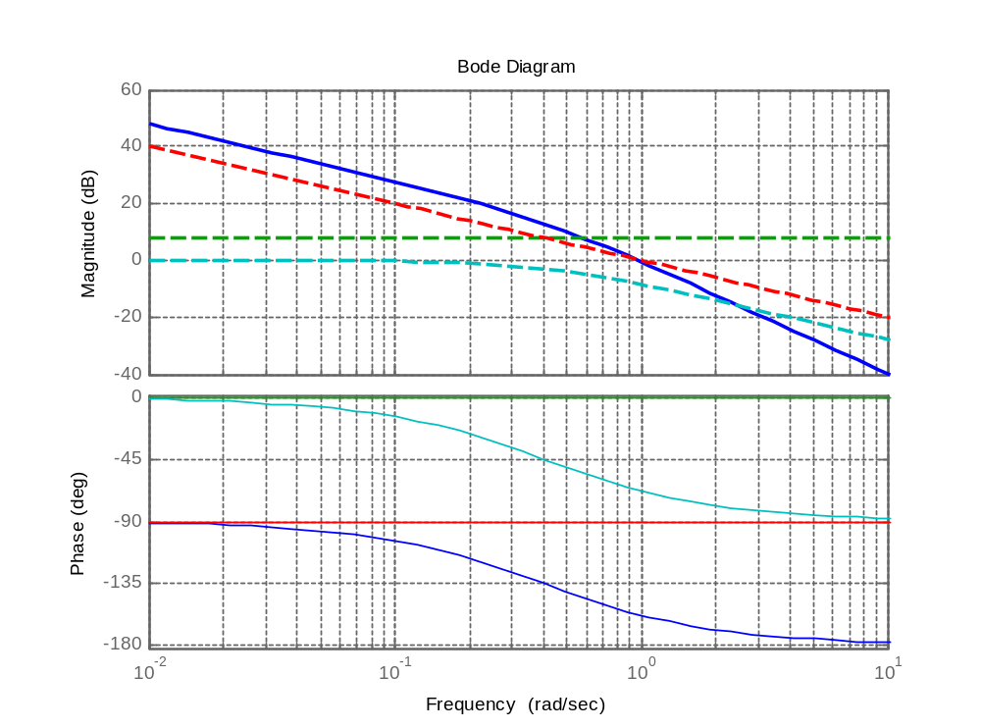
Drawing procedure
+
r
e
c
-

Slide 11


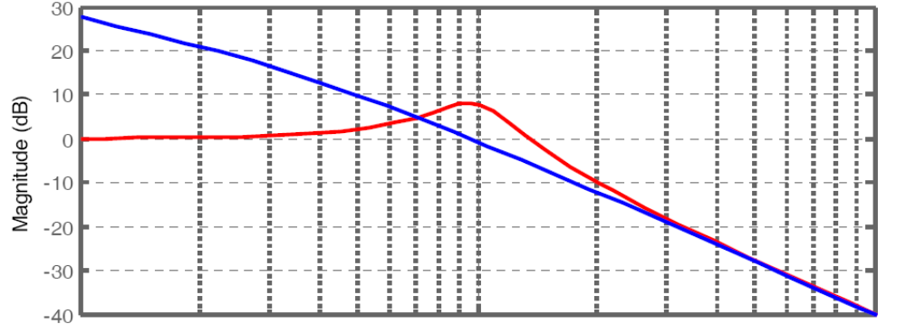
Frequency domain specification
Peak of resonance ( )
Resonance frequency ( )

Slide 12






Frequency domain specification
Closed-loop bandwidth ( )
Open - loop bandwidth ( )
Gain crossover frequency ( )
-3

Slide 13
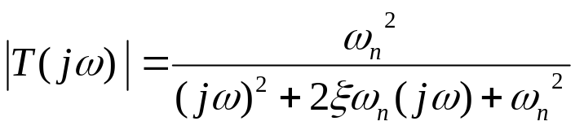
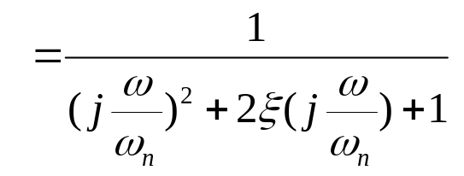
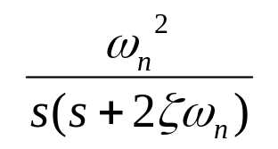
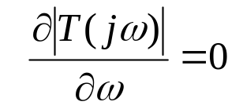

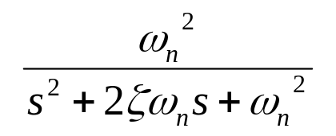

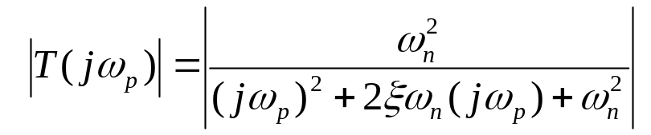

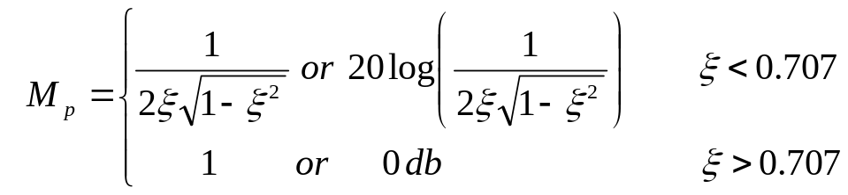
Introducing a prototype second order system.
+
e
r
c
-
Resonance frequency ( )
r
c
Peak of resonance ( )

Slide 14

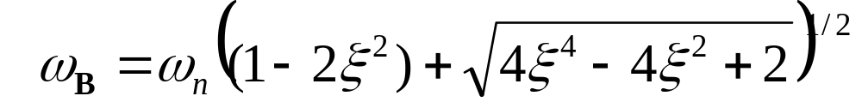
Introducing a prototype second order system.
+
e
r
c
-
Closed-loop bandwidth ( )
r
c
-3

Slide 15
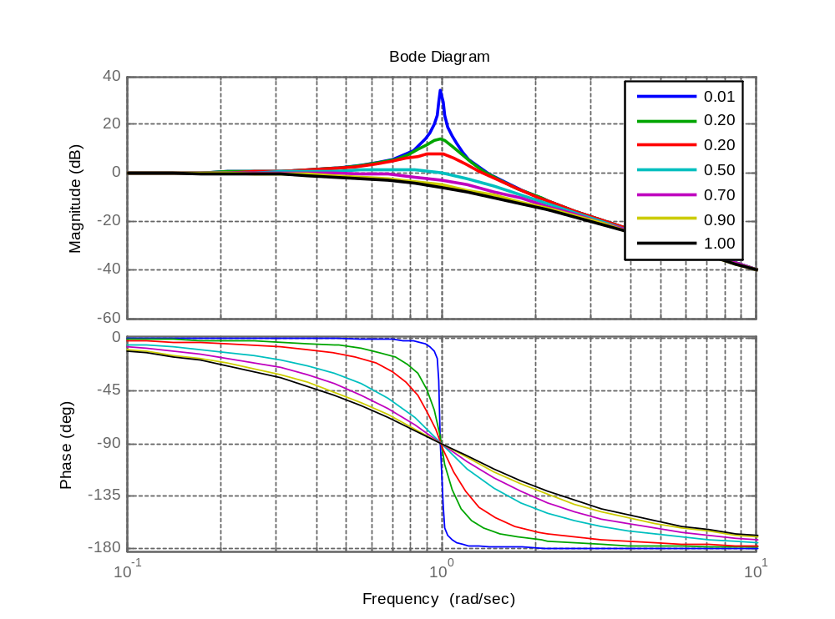
Introducing a prototype second order system.
+
e
r
c
-
r
c

Slide 16
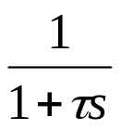
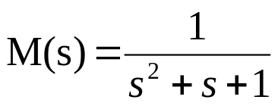

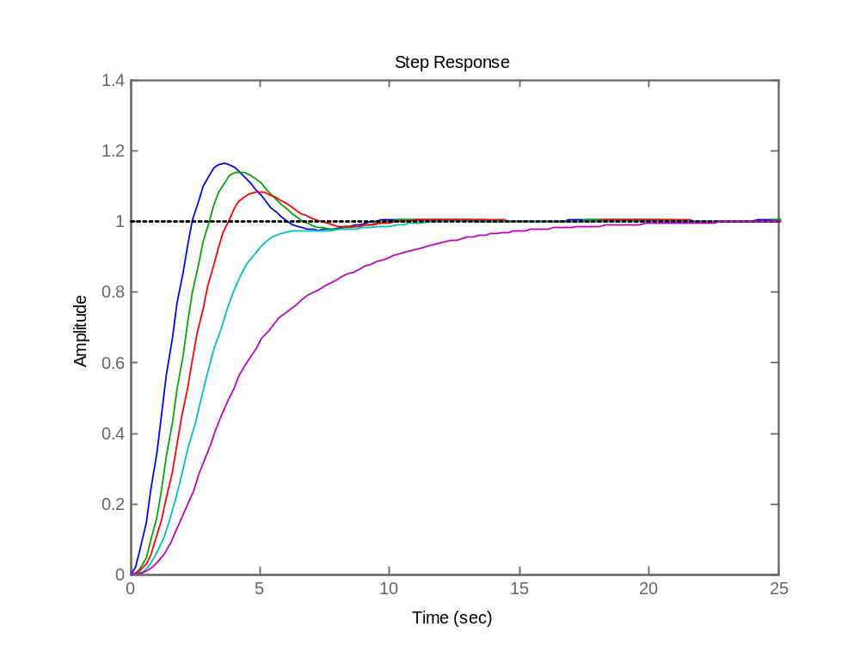
Adding poles to closed loop transfer functions
اضافه کردن قطب به تابع انتقال حلقه بسته
r
c₂
P.O.
τ=0.5
t_{r}
τ=0
τ=1.0
τ=2.0
τ=5.0
System speed
BW

Slide 17
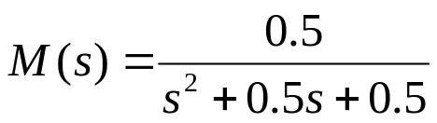


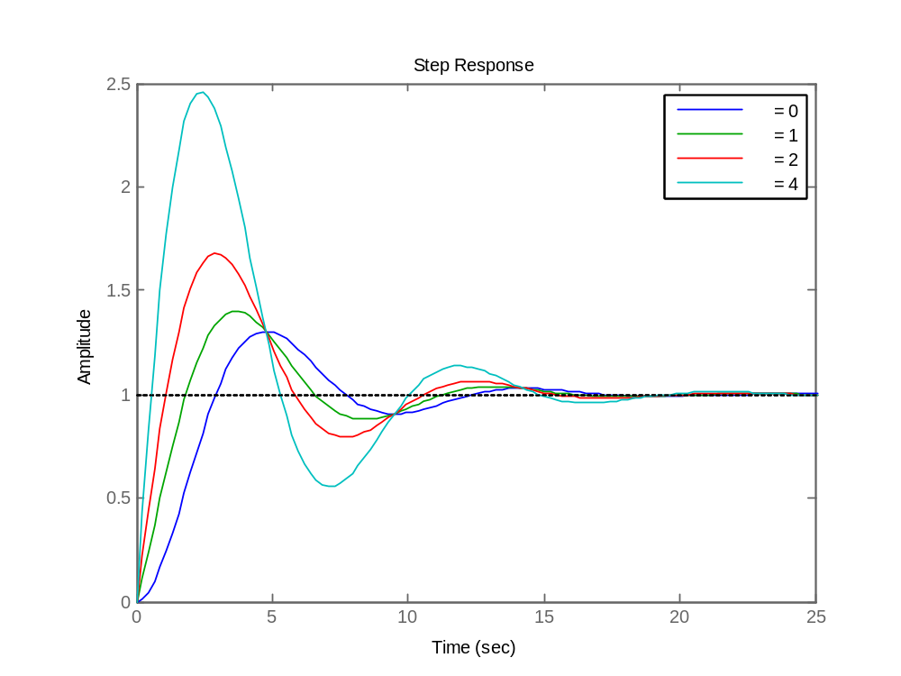
Adding zeros to closed loop transfer functions
اضافه کردن صفر به تابع انتقال حلقه بسته
r
c₁
r
c₂
P.O.
t_{r}
System speed
BW

Slide 18
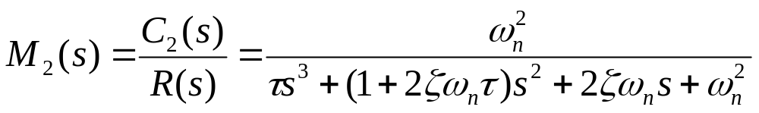


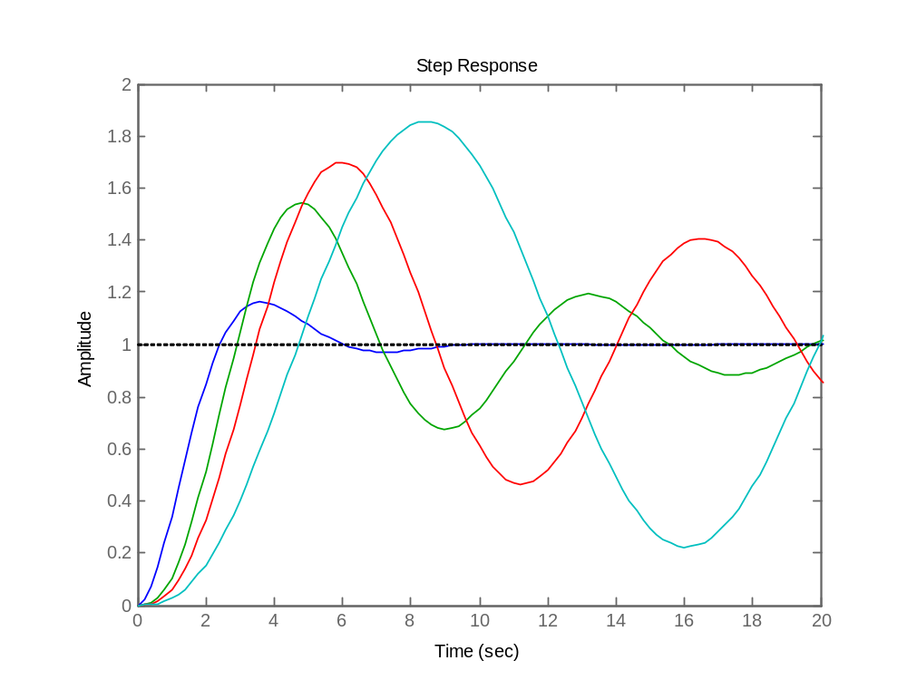
Adding poles to open loop transfer functions
اضافه کردن قطب به تابع انتقال حلقه باز
r
e
c₂
-
P.O.
τ=5.0
τ=2.0
t_{r}
τ=1.0
τ=0
System speed
BW
More problem as
poles go to ??

Slide 19

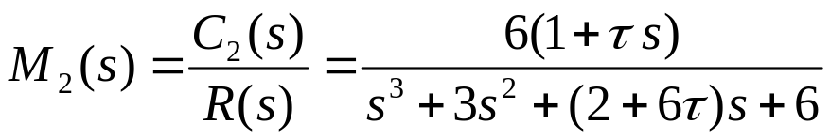

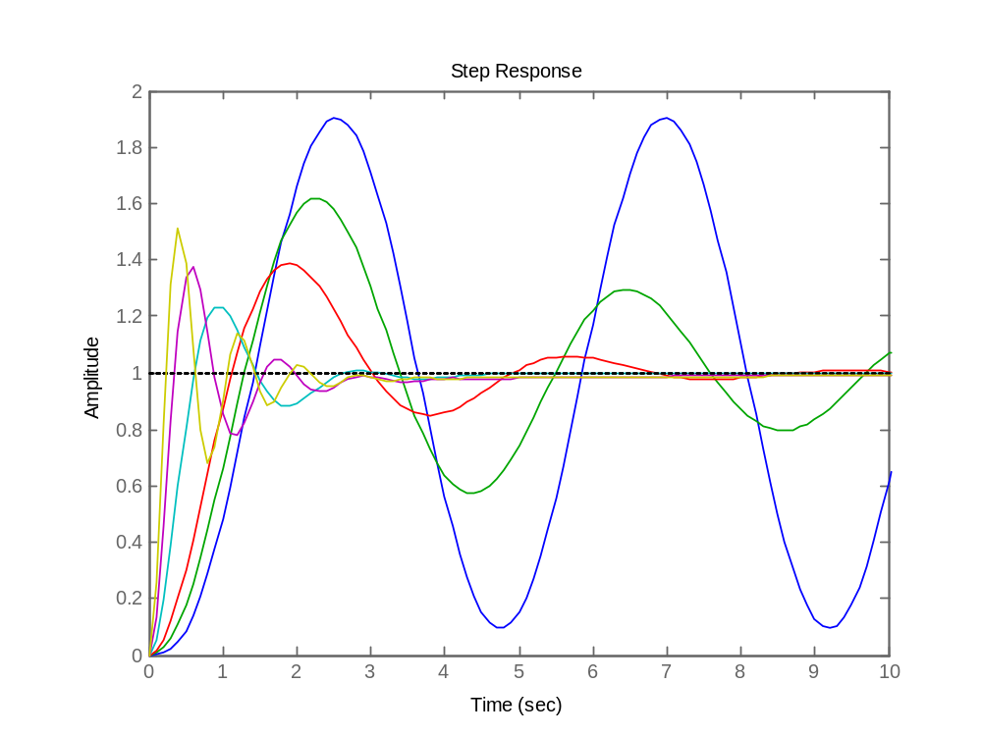
Adding zeros to open loop transfer functions
اضافه کردن صفر به تابع انتقال حلقه باز
r
e
c₂
-
P.O.
τ=0
τ=0.2
t_{r}
τ=10
τ=5.0
τ=0.5
τ=2.0
System speed
BW

